Slide 1
Spectral Graph Approximation
Clemens Damke
Intelligent Systems and Machine Learning Group
ISML Seminar, July 2019

Slide 2
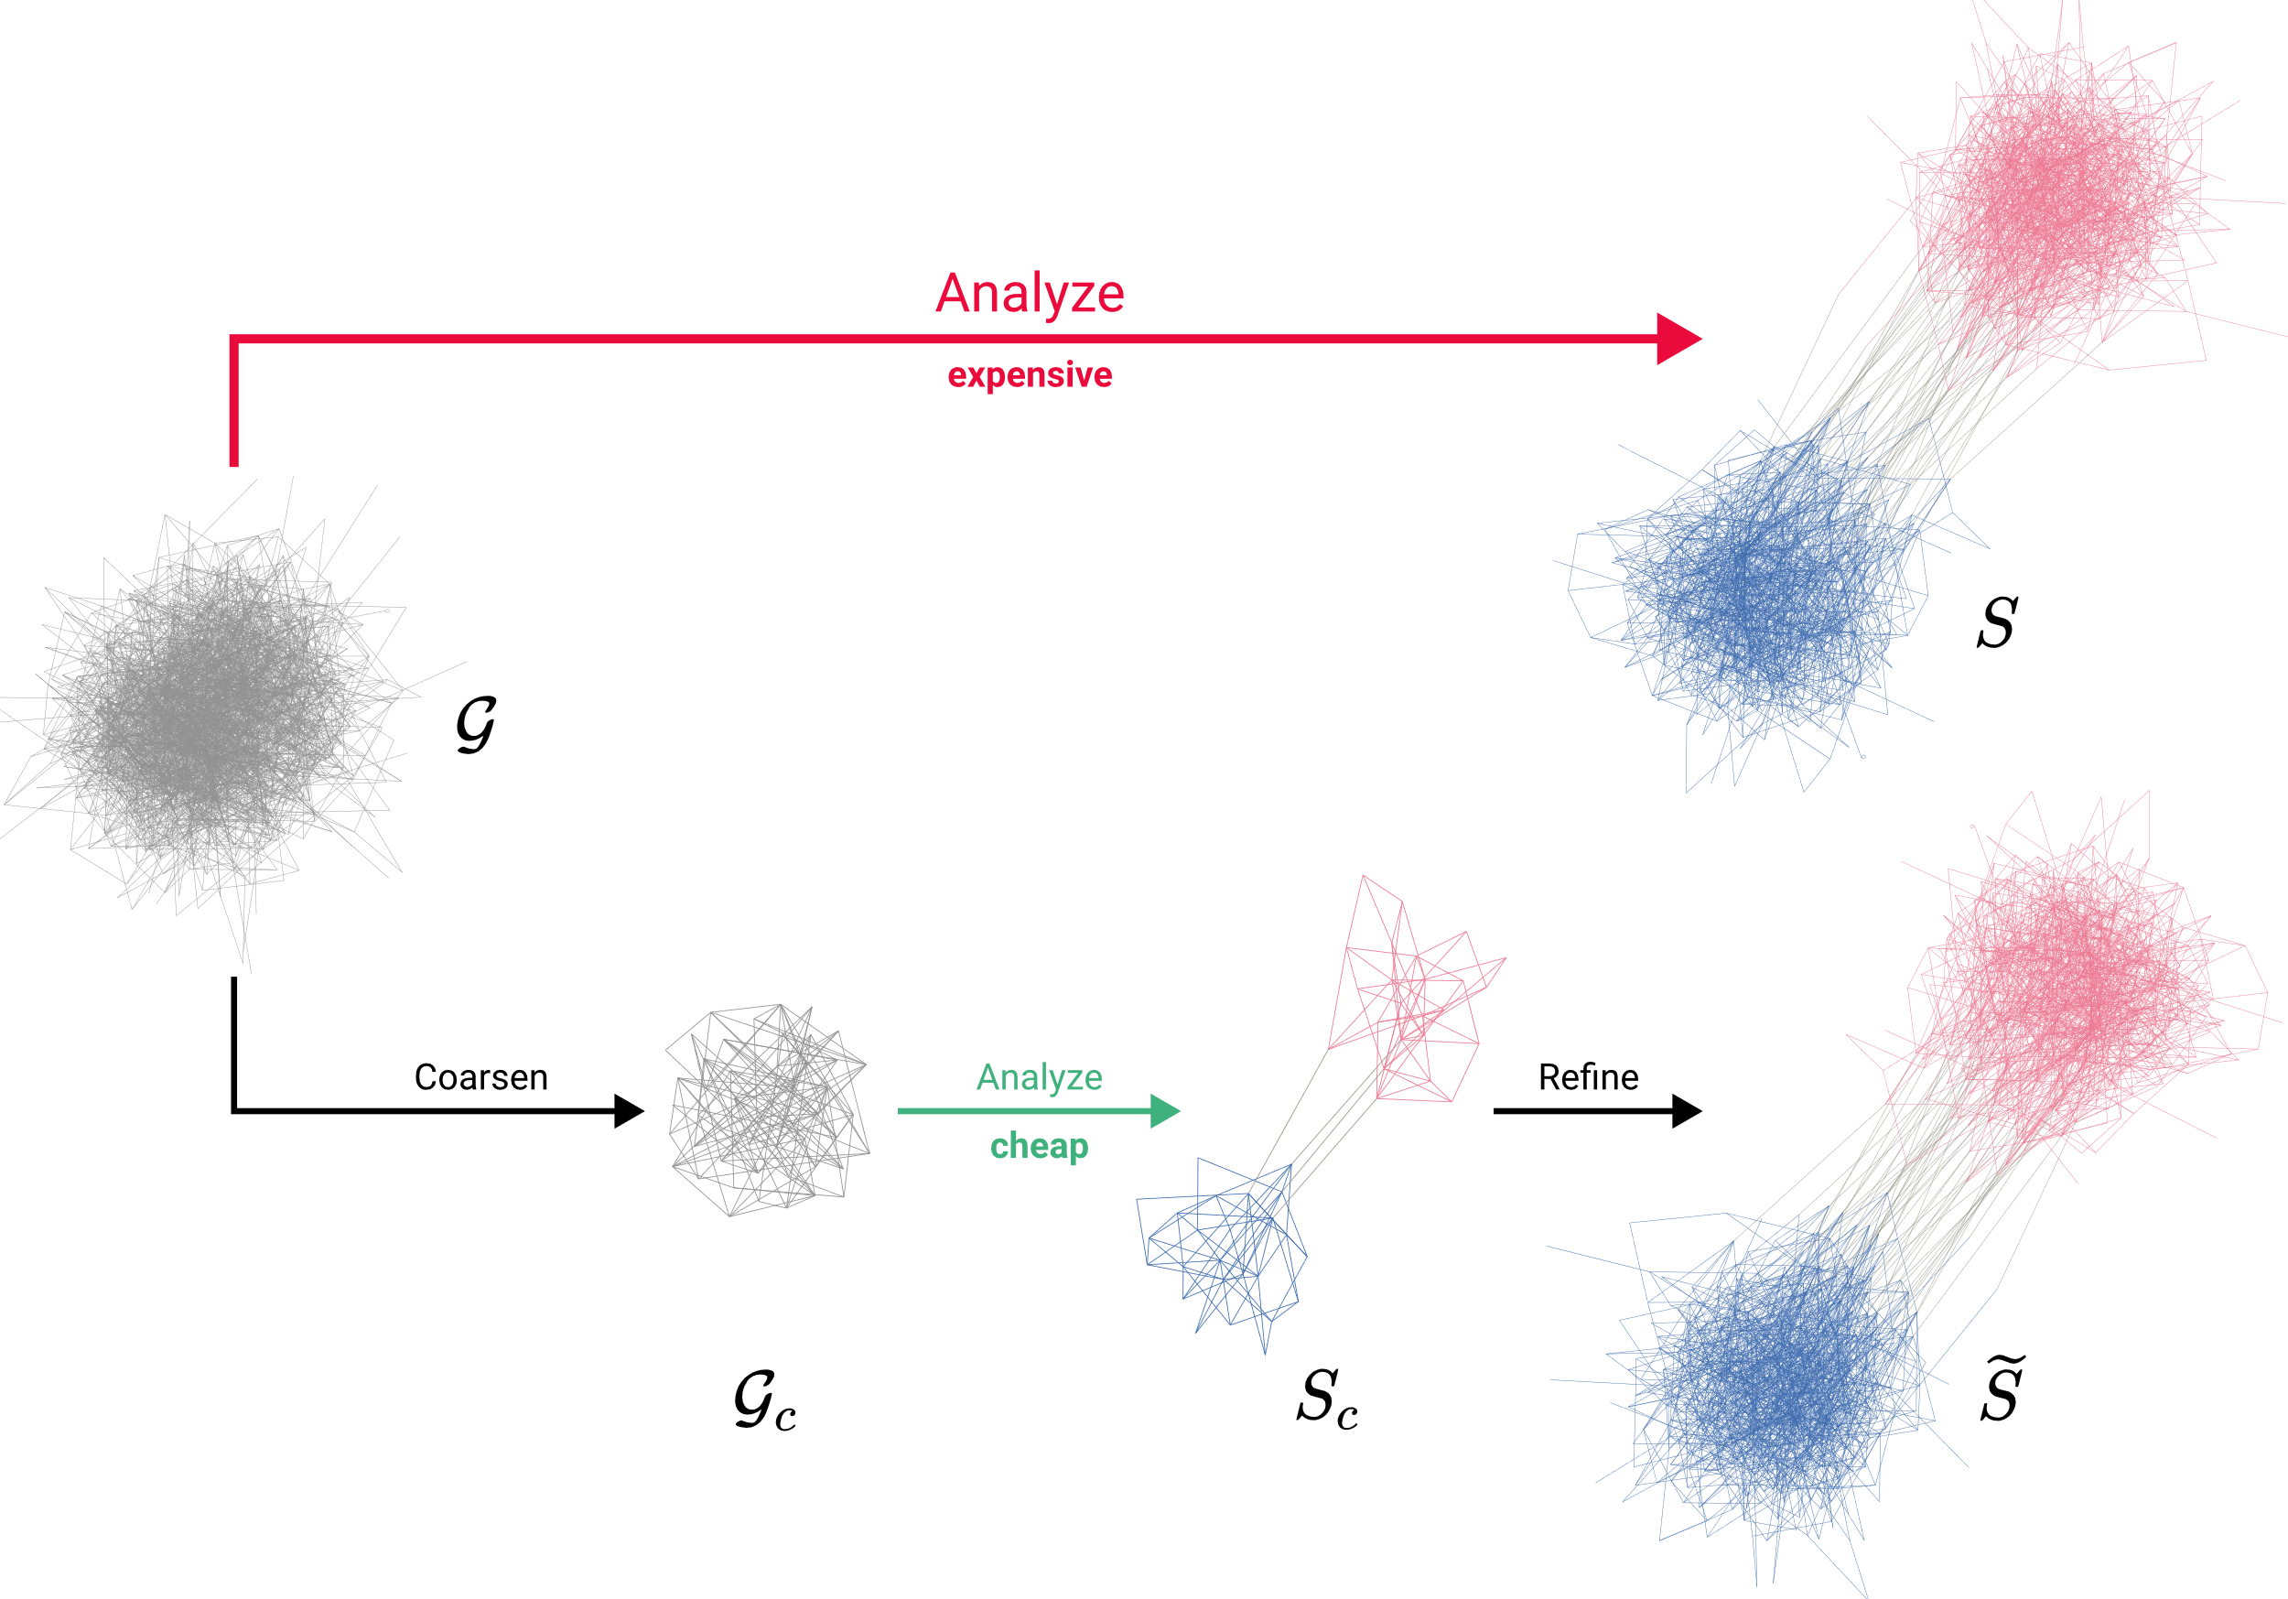
MOTIVATION

Slide 3
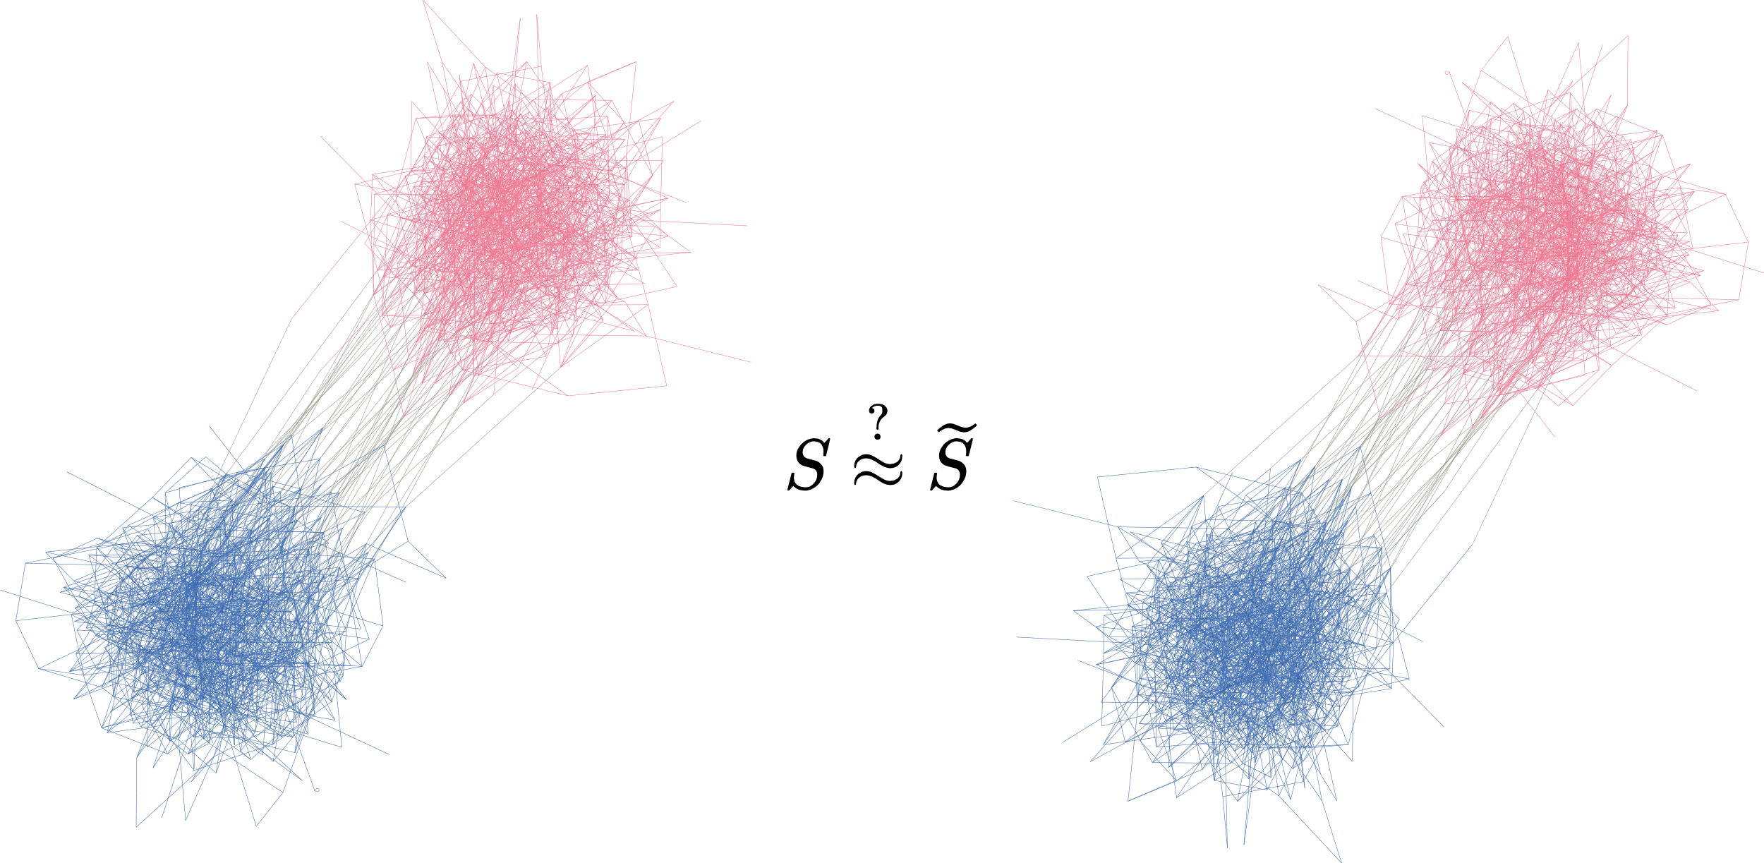
MOTIVATION
What is the effect of coarsening?

Slide 4
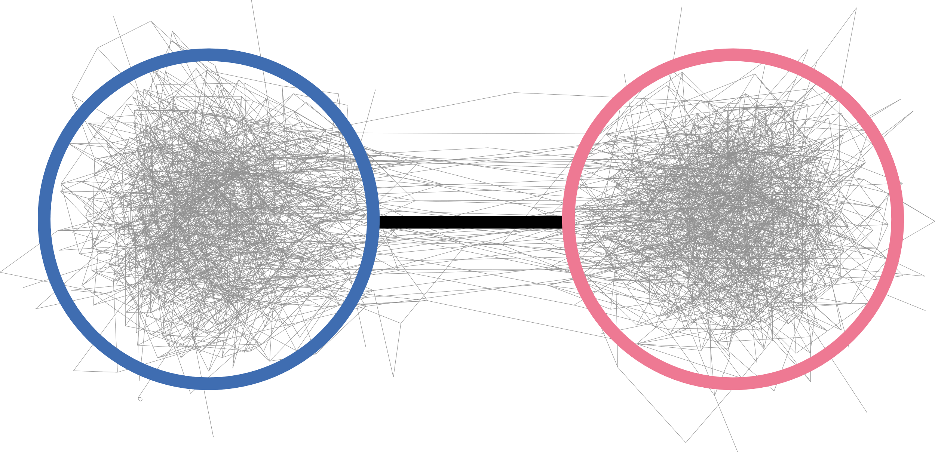
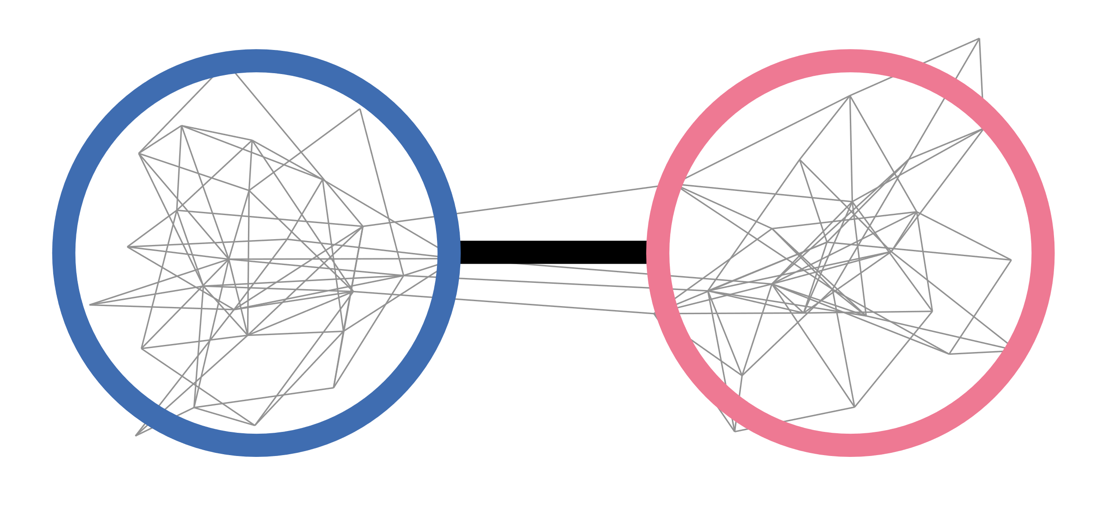
OVERVIEW
1. How to describe a graph‘s overall structure?
2. How to coarsen a graph?
3.
What is the effect of coarsening?

Slide 5
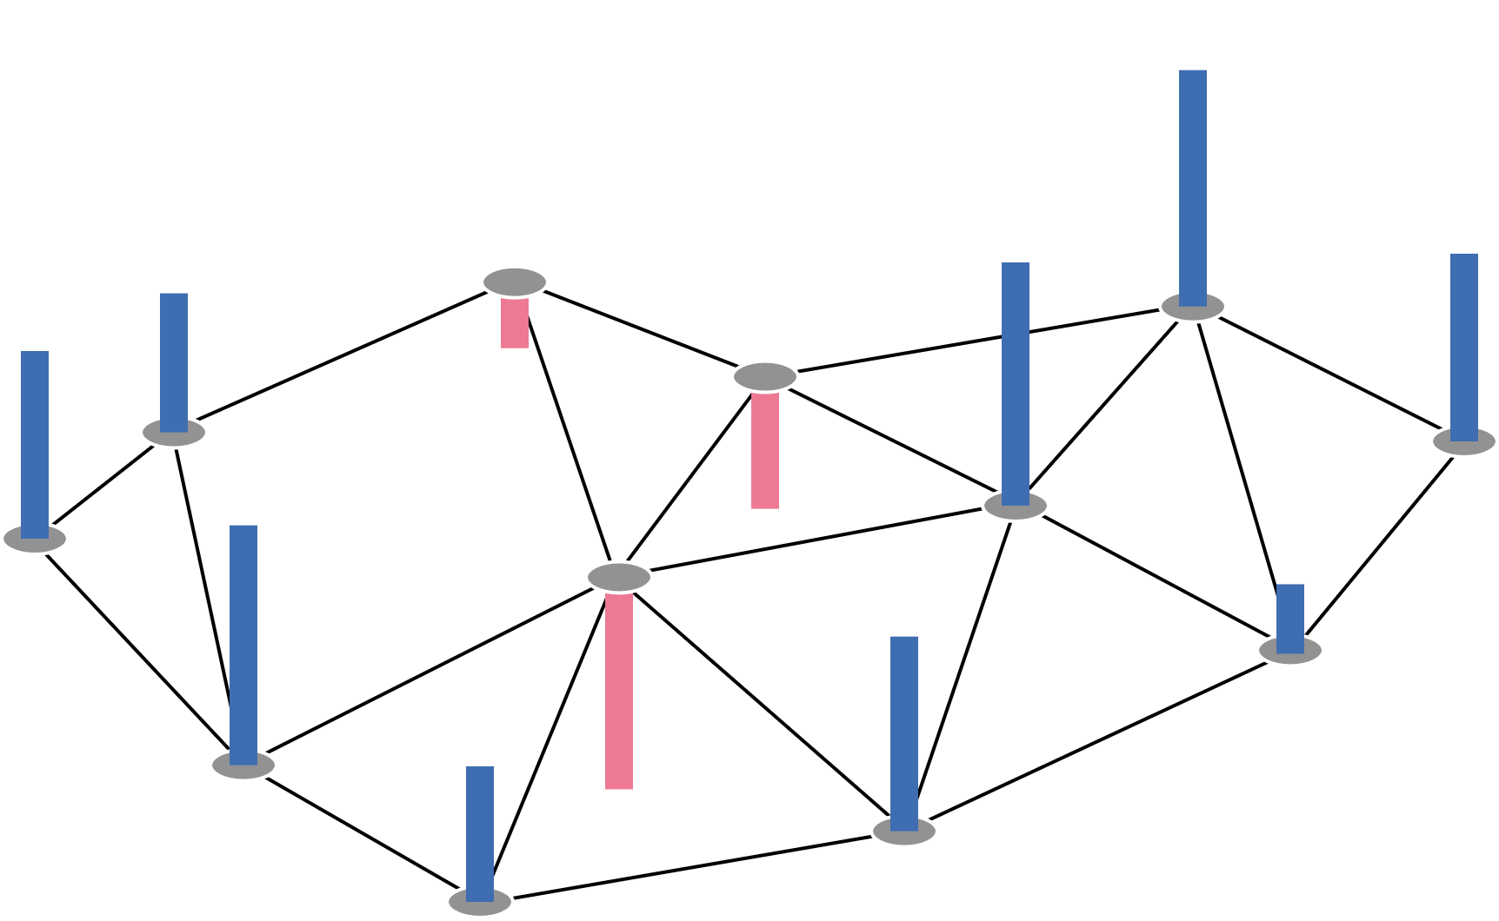
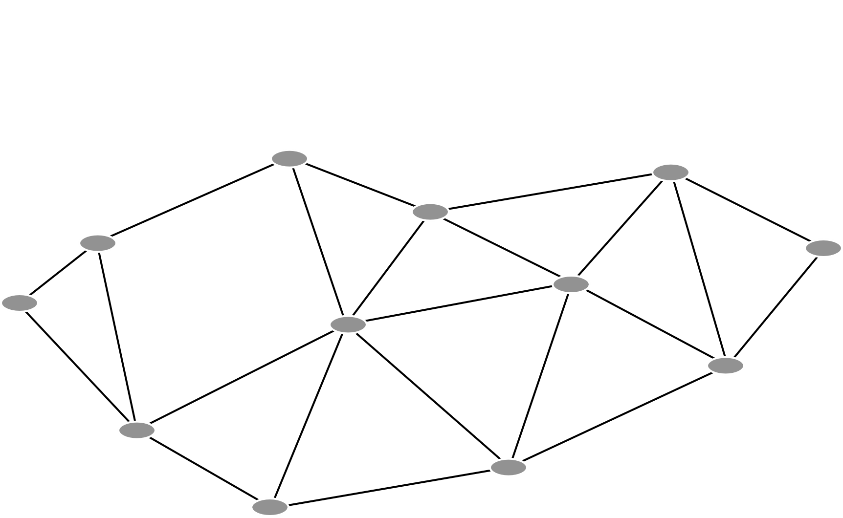
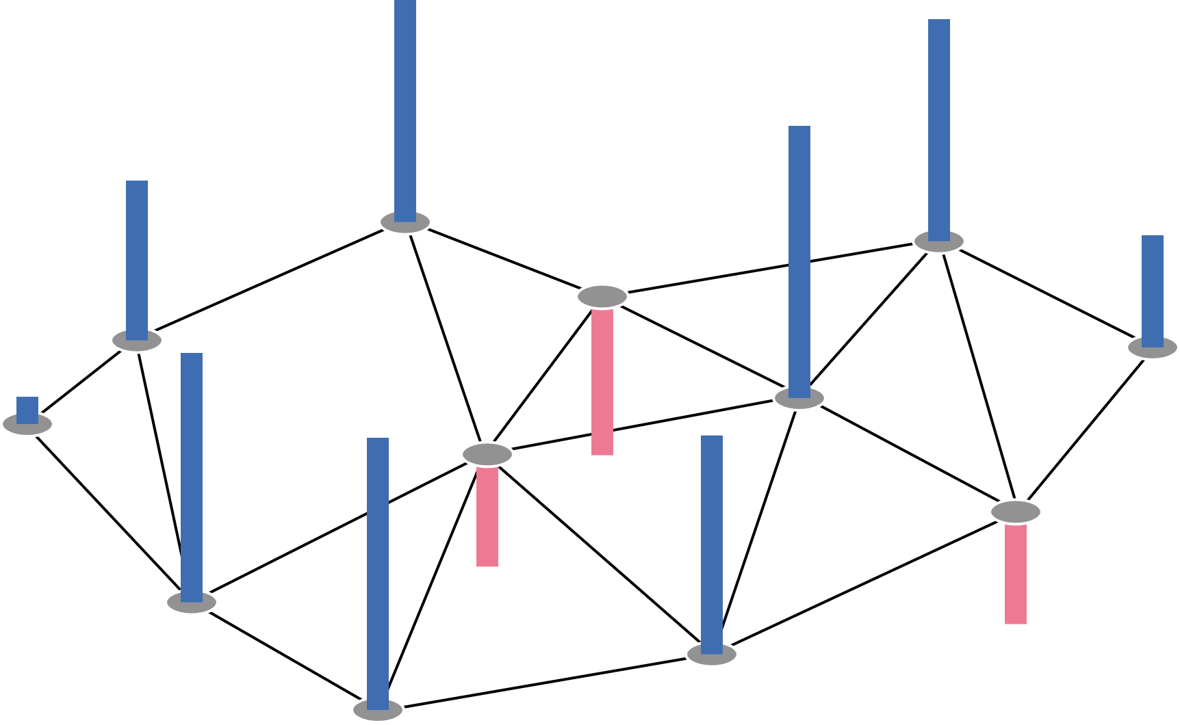
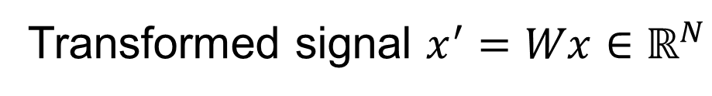
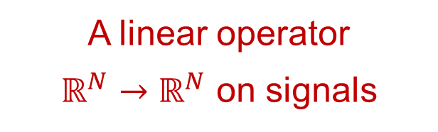

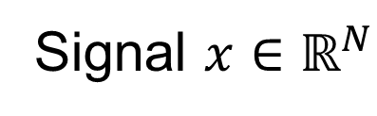
1. SPECTRAL GRAPH THEORY: Graphs as Linear Operators
$$𝒢 :=\left(𝒱, ℰ,W∈ℝ^{N×N}\right)$$
A linear operator
$ℝ^{N}→ℝ^{N}$ on signals
Transformed signal $x^{′}=Wx∈ℝ^{N}$
Signal $x∈ℝ^{N}$

Slide 6

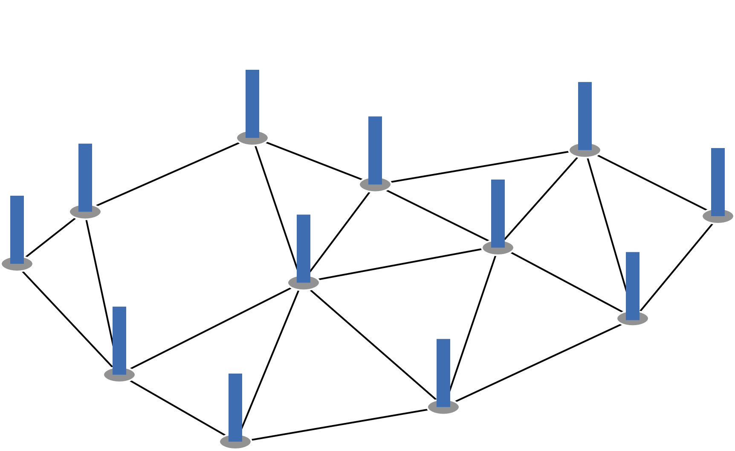
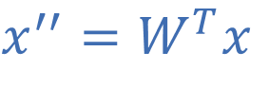
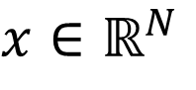
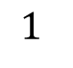

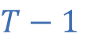
1. SPECTRAL GRAPH THEORY: Signals as Heat Distributions
Equilibrium
$$1$$
$$T−1$$
Heat Flow
$$x∈ℝ^{N}$$
$$x^{′}=Wx$$
$$x^{′′}=W^{T}x$$
Described by the Fourier Transform

Slide 7
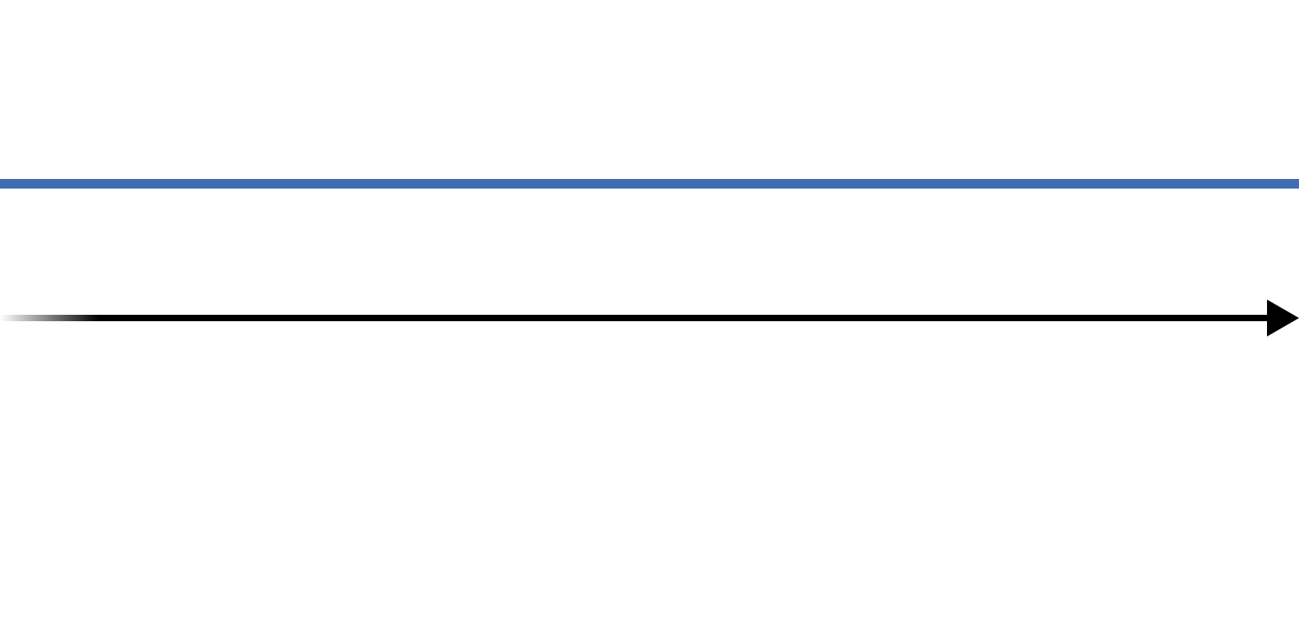
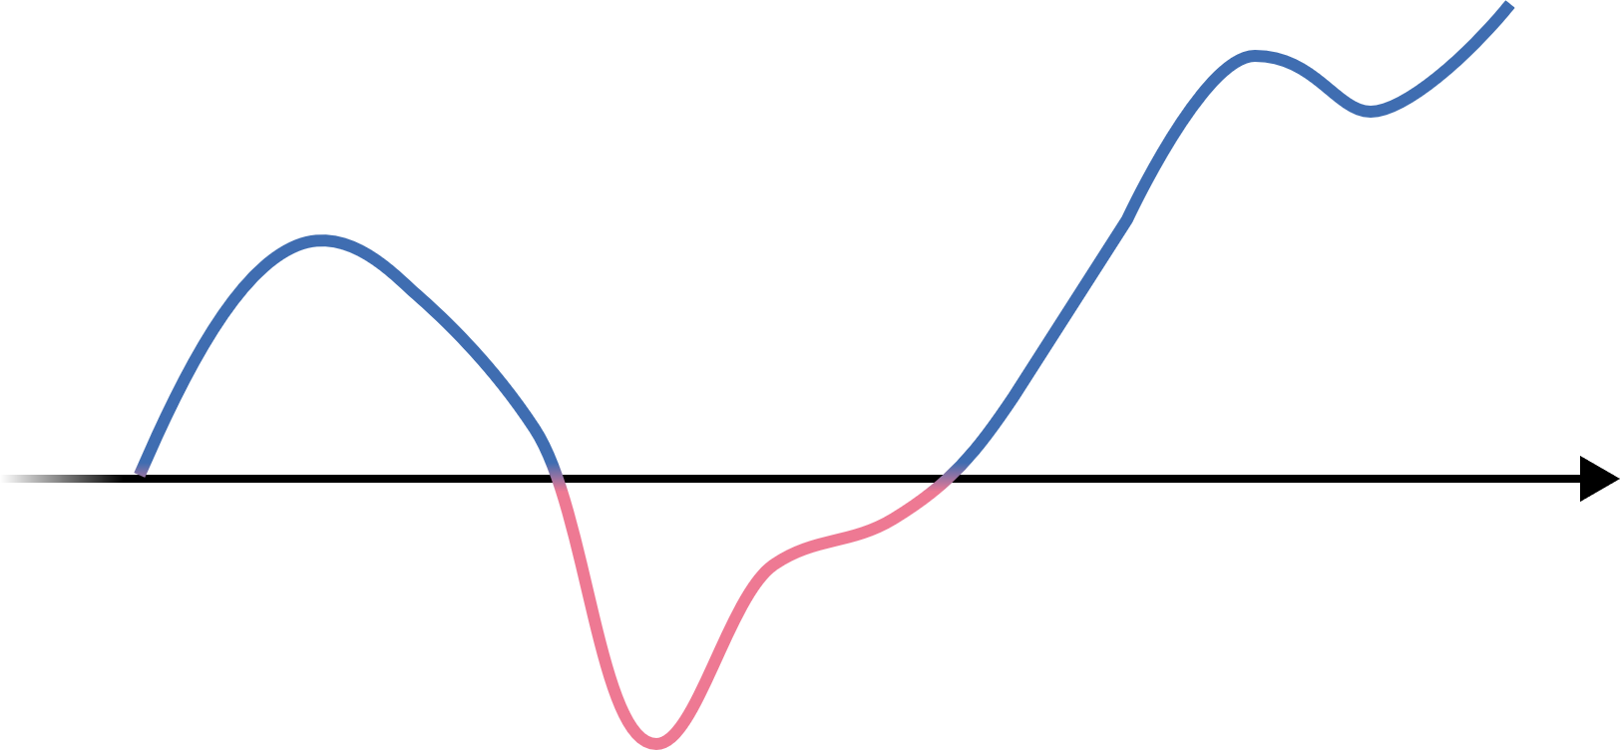
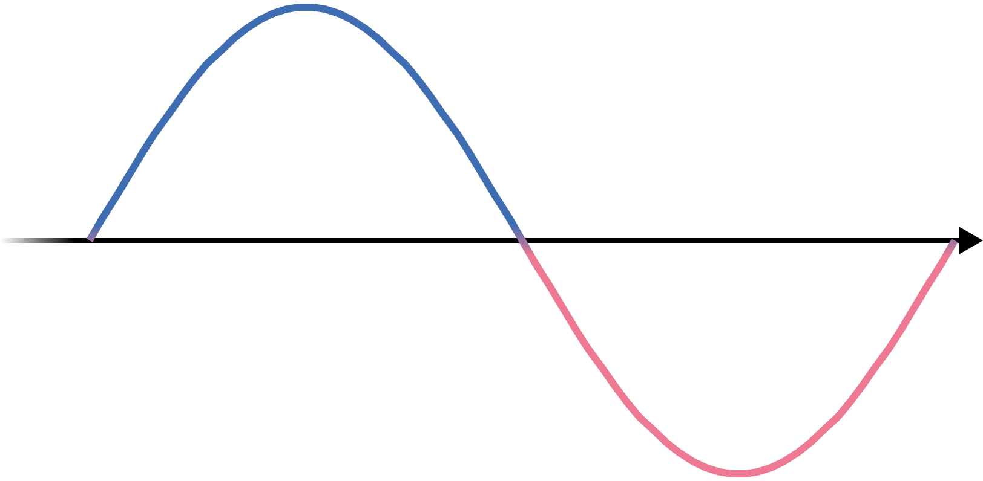
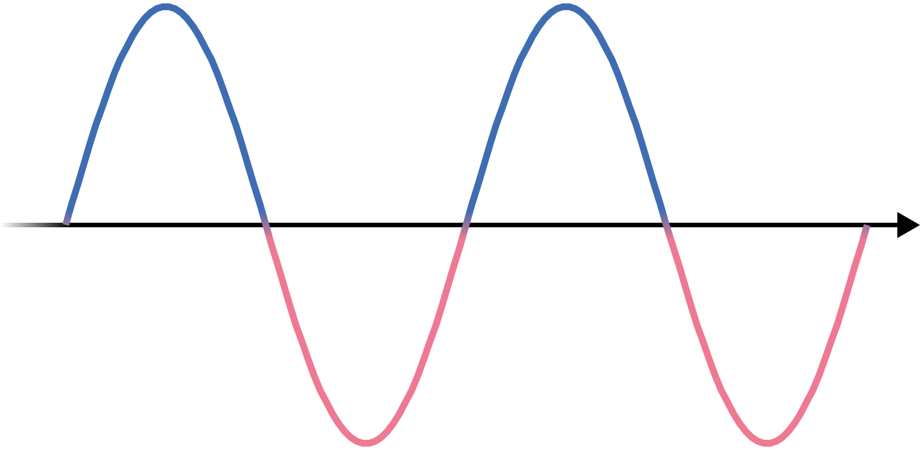
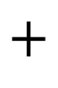
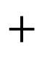
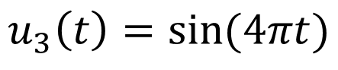
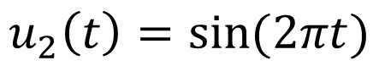
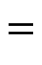
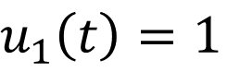


1. SPECTRAL GRAPH THEORY: The Classical Fourier Transform
$$u_{1}\left(t\right)=1$$
$$+$$
$$=$$
$$u_{2}\left(t\right)=sin⁡(2πt)$$
$$+$$
$$f: ℝ→ℝ$$
$$t⟼\int{\hat{f}(ξ){ u}_{ξ}(t)dξ}$$
$$u_{3}\left(t\right)=sin⁡(4πt)$$
$$…$$

Slide 8
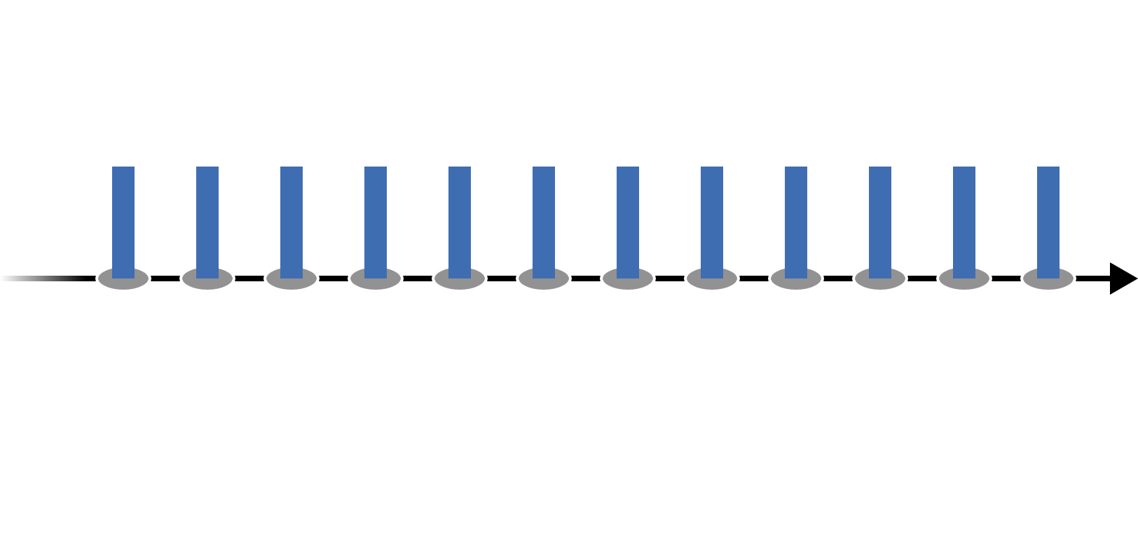
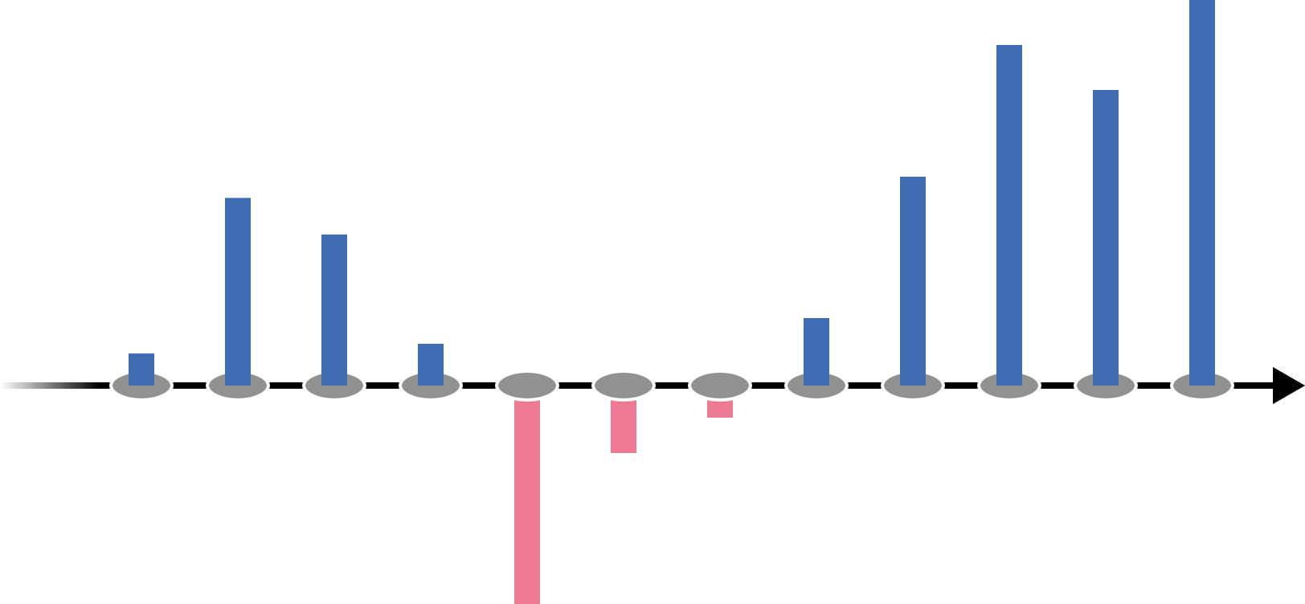
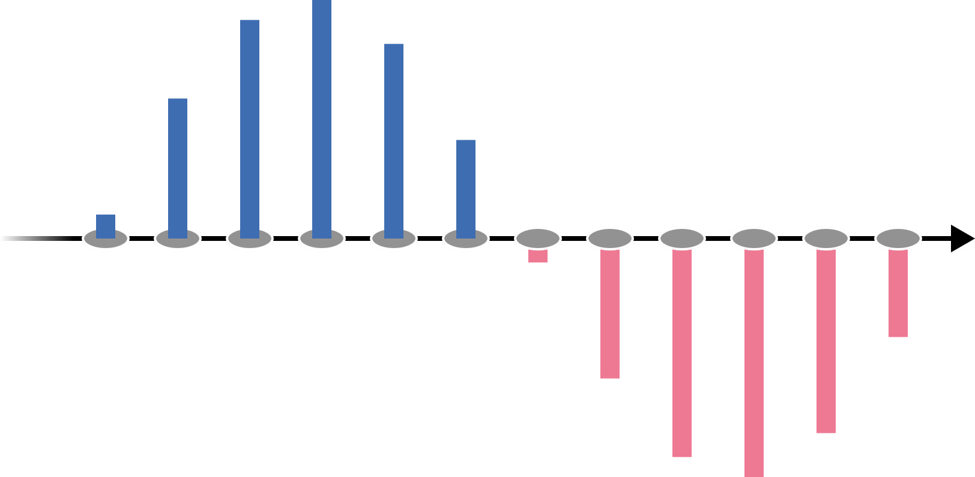
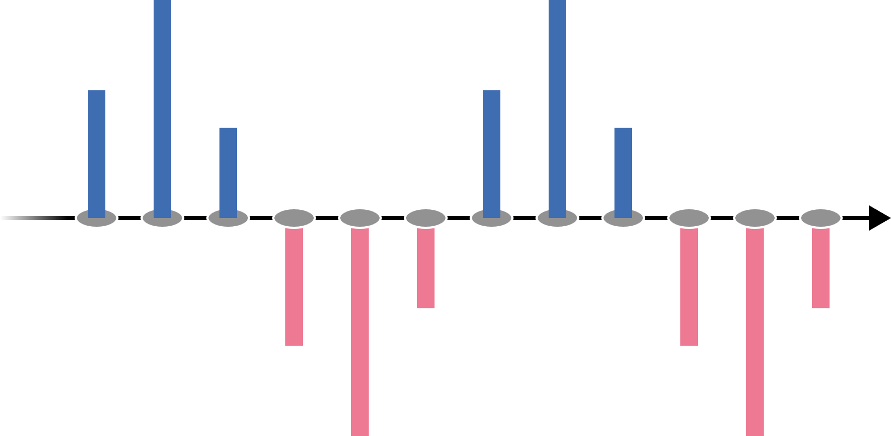
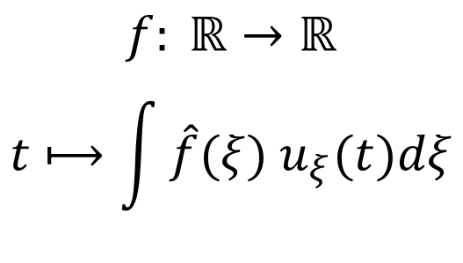
1. SPECTRAL GRAPH THEORY: Real-valued Functions as Graph Signals
$$u_{1}\left(t\right)=1$$
$$+$$
$$=$$
$$u_{2}\left(t\right)=sin⁡(2πt)$$
$$+$$
$$f: ℝ→ℝ$$
$$t⟼\int{\hat{f}(ξ){ u}_{ξ}(t)dξ}$$
$$u_{3}\left(t\right)=sin⁡(4πt)$$
How to generalize for arbitrary graphs?
$$…$$

Slide 9
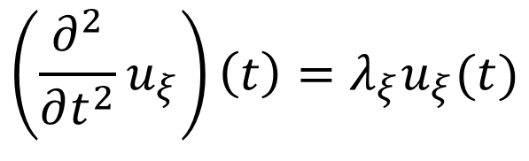
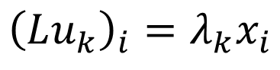
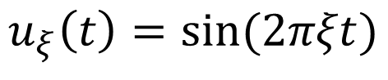
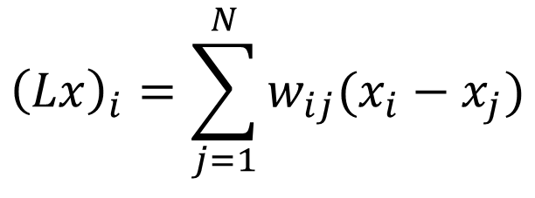
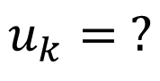
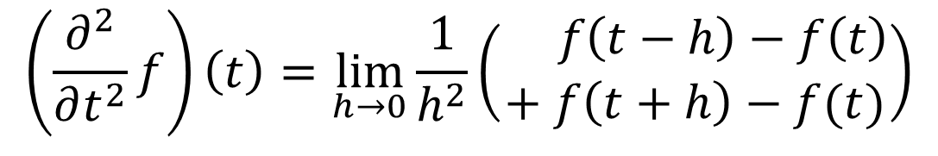
1. SPECTRAL GRAPH THEORY: The Graph Laplacian
$${\left(Lx\right)}_{i}=\sum_{j=1}^{N}{w_{ij}(x_{i}−x_{j})}$$
$$\left(\frac{∂^{2}}{∂t^{2}}f\right)\left(t\right)=\lim_{h→0}{\frac{1}{h^{2}}\left(\begin{aligned} f\left(t−h\right)−f\left(t\right) \\ + f\left(t+h\right)−f(t)\end{aligned}\right)}$$
$$\left(\frac{∂^{2}}{∂t^{2}}u_{ξ}\right)\left(t\right)=λ_{ξ}u_{ξ}(t)$$
$${\left(Lu_{k}\right)}_{i}=λ_{k}x_{i}$$
$$u_{ξ}\left(t\right)=sin⁡(2πξt)$$
$$u_{k}= ?$$

Slide 10
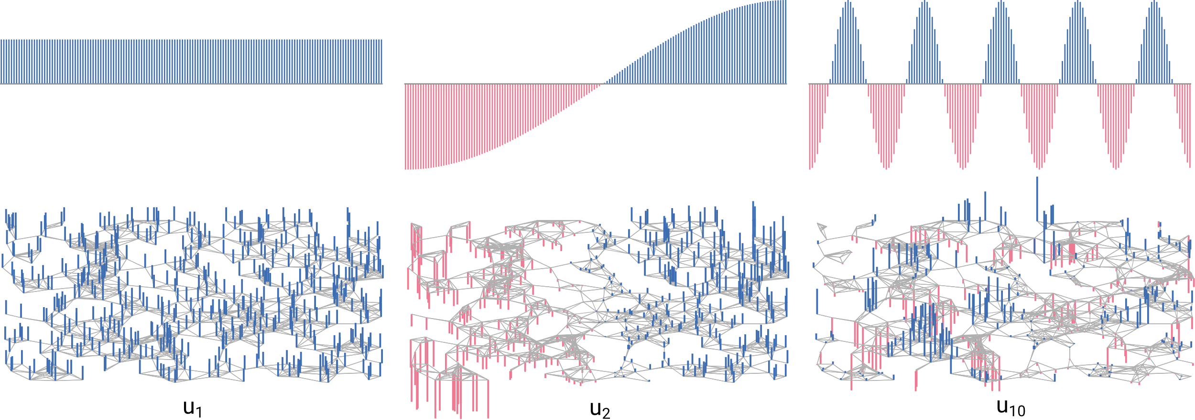

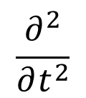
1. SPECTRAL GRAPH THEORY: Laplacian Eigenvectors
$$\frac{∂^{2}}{∂t^{2}}$$
$$L$$

Slide 11
OVERVIEW
1. Spectral Graph Theory
2. How to coarsen a graph?
3.
What is the effect of coarsening?

Slide 12
OVERVIEW
1. Spectral Graph Theory
2. REC Coarsening
3.
What is the effect of coarsening?

